Slide 1
Chapter 8: Testing Hypotheses

Slide 2
Assumptions of Statistical Hypothesis Testing
Several assumptions.
All assume random sampling.
Assumptions while testing hypothesis.
Notes:
Satisfies Learning Objective 8.1: Describe the assumptions of statistical hypothesis testing.
Statistical hypothesis testing (a procedure that allows us to evaluate hypotheses about population parameters based on sample statistics).
Several assumptions: Statistical hypothesis testing requires several assumptions.
These assumptions include considerations of the level of measurement of the variable, the method of sampling, the shape of the population distribution, and the sample size.
The specific assumptions may vary, depending on the test or the conditions of testing.
Assumptions while testing hypothesis: Tests of hypotheses about means also assume interval-ratio level of measurement and require that the population under consideration be normally distributed or that the sample size be larger than 50.

Slide 3
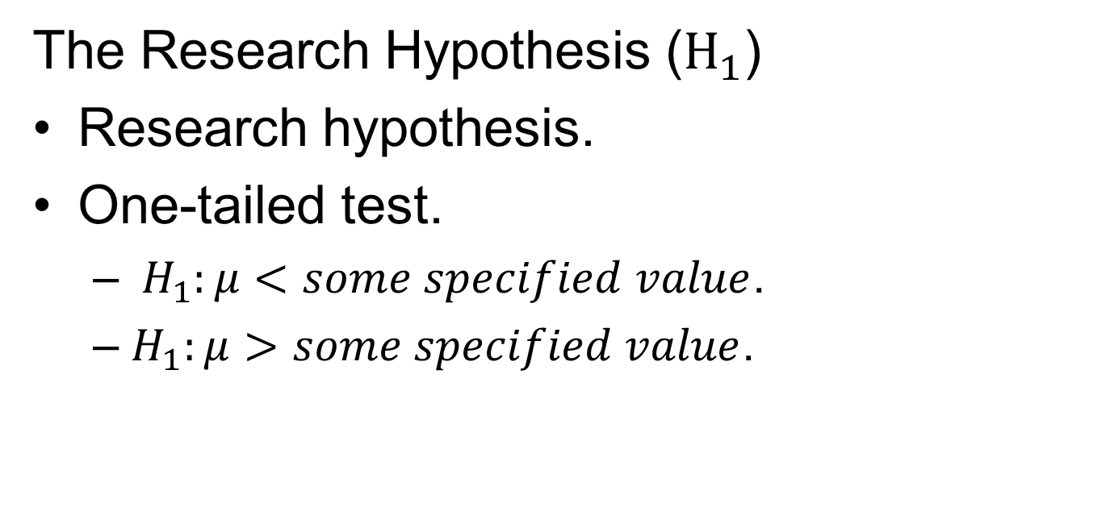
Stating the Research and Null Hypotheses (1 of 3)
The Research Hypothesis ($H_{1}$)
Research hypothesis.
One-tailed test.
$H_{1}:μ<Some specified value$.
$H_{1}:μ>Some specified value$.
Notes:
Satisfies Learning Objective 8.2: Define and apply the components in hypothesis testing.
Research hypothesis: The substantive hypothesis is called the research hypothesis and is symbolized as $H_{1}$. Research hypotheses are always expressed in terms of population parameters because we are interested in making statements about population parameters based on our sample statistics. In general, the research hypothesis ($H_{1}$) specifies that the population parameter is one of the following:
Not equal to some specified value: μ ≠ some specified value.
Greater than some specified value: μ > some specified value.
Less than some specified value: μ < some specified value.
One-tailed test: A type of hypothesis test that involves a directional research hypothesis. It specifies that the values of one group are either larger or smaller than some specified population value. In a one-tailed test, the research hypothesis is directional, that is, it specifies that a population mean is either less than (<) or greater than (>) some specified value. We can express our research hypothesis as either:
$H_{1}: μ<some specified value$.
$H_{1}: μ>some specified value$.

Slide 4
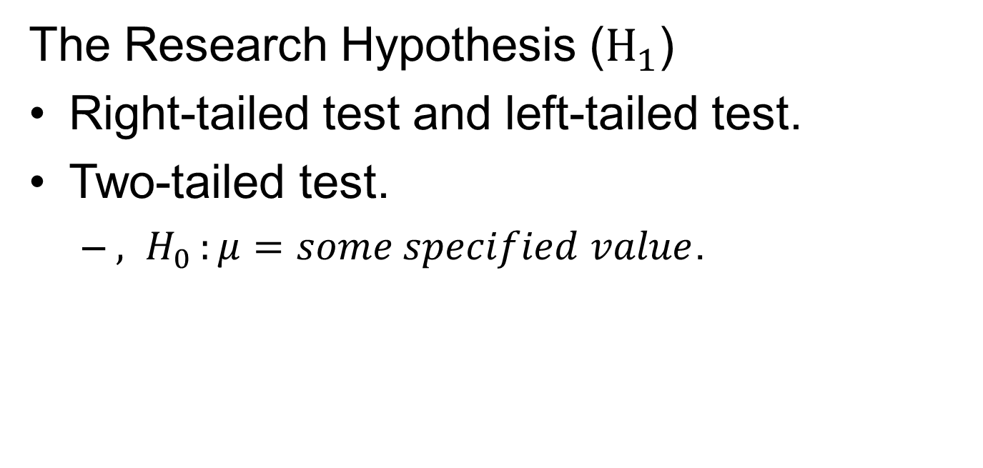
Stating the Research and Null Hypotheses (2 of 3)
The Research Hypothesis ($H_{1}$)
Right-tailed test and left-tailed test.
Two-tailed test.
$H_{0}:μ=Some specified value$.
Notes:
Satisfies Learning Objective 8.2: Define and apply the components in hypothesis testing.
Right-tailed test and left-tailed test: When a one-tailed test specifies that the population mean is greater than some specified value, it is called a right-tailed test because we will evaluate the outcome at the right tail of the sampling distribution. If the research hypothesis specifies that the population mean is less than some specified value, it is called a left-tailed test because the outcome will be evaluated at the left tail of the sampling distribution.
Two-tailed test: When we have no theoretical reason for specifying a direction in the research hypothesis, we conduct a two-tailed test. The research hypothesis specifies that the population mean is not equal to some specified value. With both one- and two-tailed tests, our null hypothesis of no difference remains the same. It can be expressed as${, H}_{0}:μ=some specified value$.

Slide 5
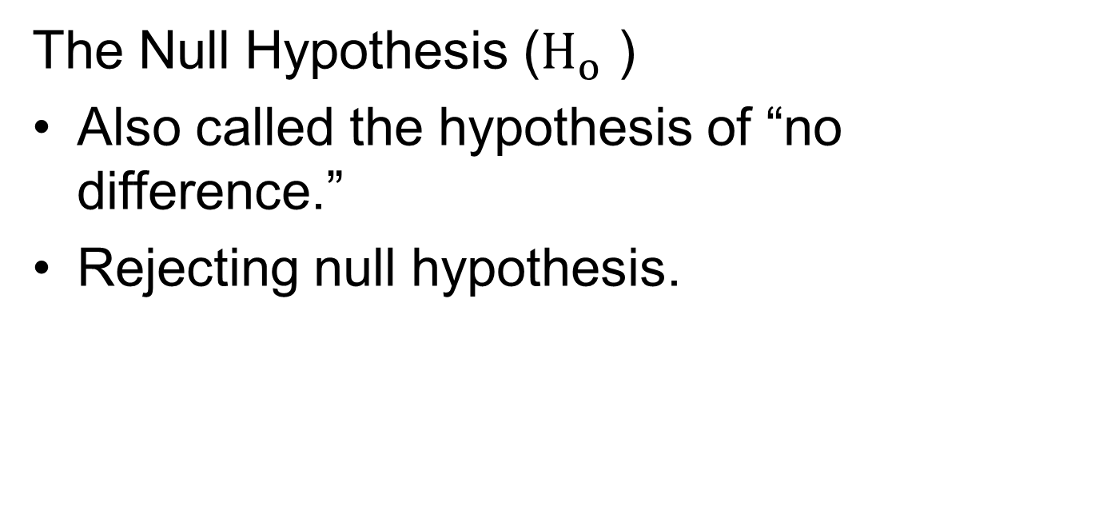
Stating the Research and Null Hypotheses (3 of 3)
The Null Hypothesis ($H_{o}$ )
Also called the hypothesis of “no difference.”
Rejecting null hypothesis.
Notes:
Satisfies Learning Objective 8.3: Explain what it means to reject or fail to reject a null hypothesis.
Null hypothesis: The null hypothesis, symbolized as${ H}_{0}$, contradicts the research hypothesis and states that there is no difference between the population mean and some specified value. It is also referred to as the hypothesis of “no difference.”
Rejecting null hypothesis: In hypothesis testing, we hope to reject the null hypothesis to provide indirect support for the research hypothesis.

Slide 6
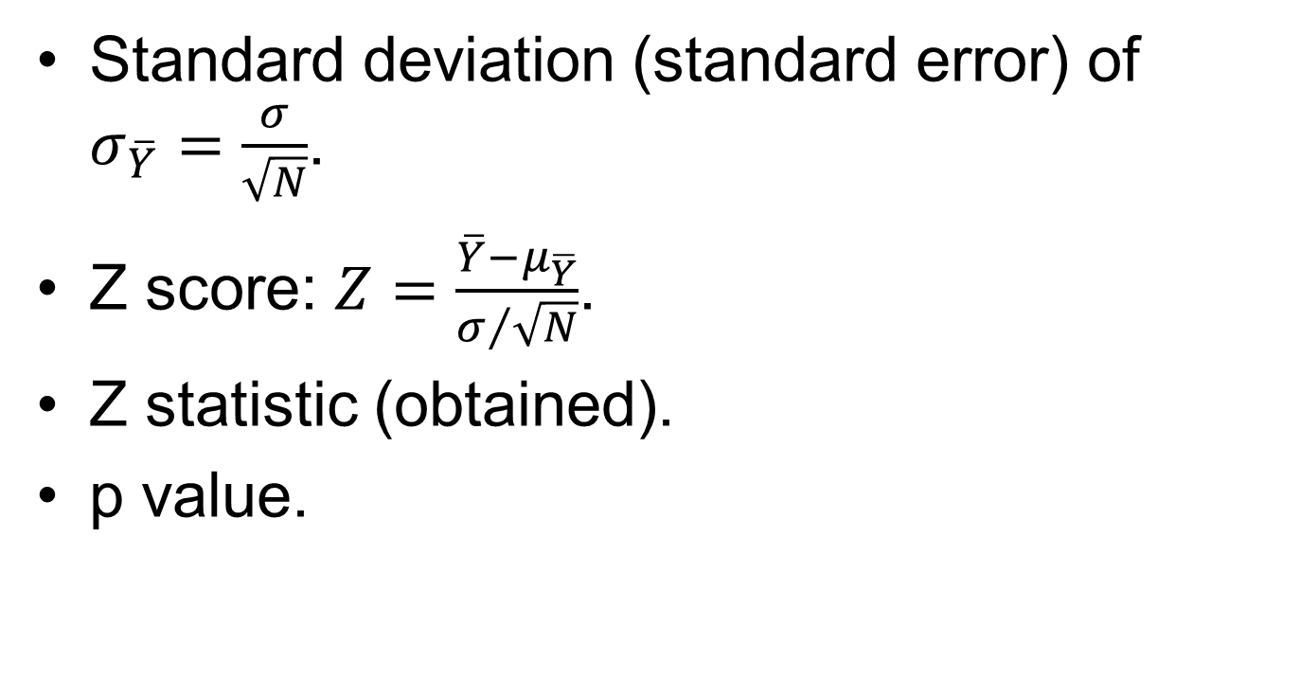
Probability Values and Alpha (1 of 2)
Standard deviation (standard error) of $σ_{\overline{Y}}=\frac{σ}{\sqrt{N}}$.
Z score: $Z=\frac{\overline{Y}−μ_{\overline{Y}}}{σ/{\sqrt{N}}}$.
Z statistic (obtained).
p Value.
Notes:
Satisfies Learning Objective 8.5: Determine the significance of t-test and Z-test statistics.
Z score: Modified formula, $Z=\frac{\overline{Y}−μ_{\overline{Y}}}{σ/{\sqrt{N}}}$.
Raw score is Y (the mean), and the standard deviation (standard error) is $σ/{\sqrt{N}}.$
Z statistic (obtained): Converting the sample mean to a Z score equivalent is called computing the test statistic. The Z value obtain is called the Z statistic (obtained).
p Value: It can be defined as the probability associated with the obtained value of Z. It is a measure of how unusual or rare our obtained statistic is compared with what is stated in our null hypothesis.

Slide 7

Probability Values and Alpha (2 of 2)
Alpha ($α$).
Difference between p and alpha.
Notes:
Satisfies Learning Objective 8.5: Determine the significance of t-test and Z-test statistics.
Alpha: Researchers usually define in advance what a sufficiently improbable Z value is by specifying a cutoff point below which p must fall to reject the null hypothesis. This cutoff point, called alpha and denoted by the Greek letter $α$, is customarily set at the 0.05, 0.01, or 0.001 level.
The difference between p and alpha: p is the actual probability associated with the obtained value of Z, whereas alpha is the level of probability determined in advance at which the null hypothesis is rejected. The null hypothesis is rejected when $p ≤ α$.

Slide 8
The Five Steps in Hypothesis Testing: A Summary (1 of 2)
Making assumptions.
Stating research and null hypotheses and selecting alpha.
Selecting sampling distribution and specifying test statistic.
Notes:
Satisfies Learning Objective 8.2: Define and apply the components in hypothesis testing.
Making assumptions: Statistical hypothesis testing involves making several assumptions regarding the level of measurement of the variable, the method of sampling, the shape of the population distribution, and the sample size.
Stating the research and null hypotheses and selecting alpha: The null hypothesis, symbolized as $H_{0},$contradicts the research hypothesis in a statement of no difference between the population mean and our hypothesized value.
Selecting the sampling distribution and specifying the test statistic: The normal distribution and the Z statistic are used to test the null hypothesis.

Slide 9
The Five Steps in Hypothesis Testing: A Summary (2 of 2)
Computing the test statistic.
Making decision and interpreting results.
Notes:
Satisfies Learning Objective 8.2: Define and apply the components in hypothesis testing.

Slide 10
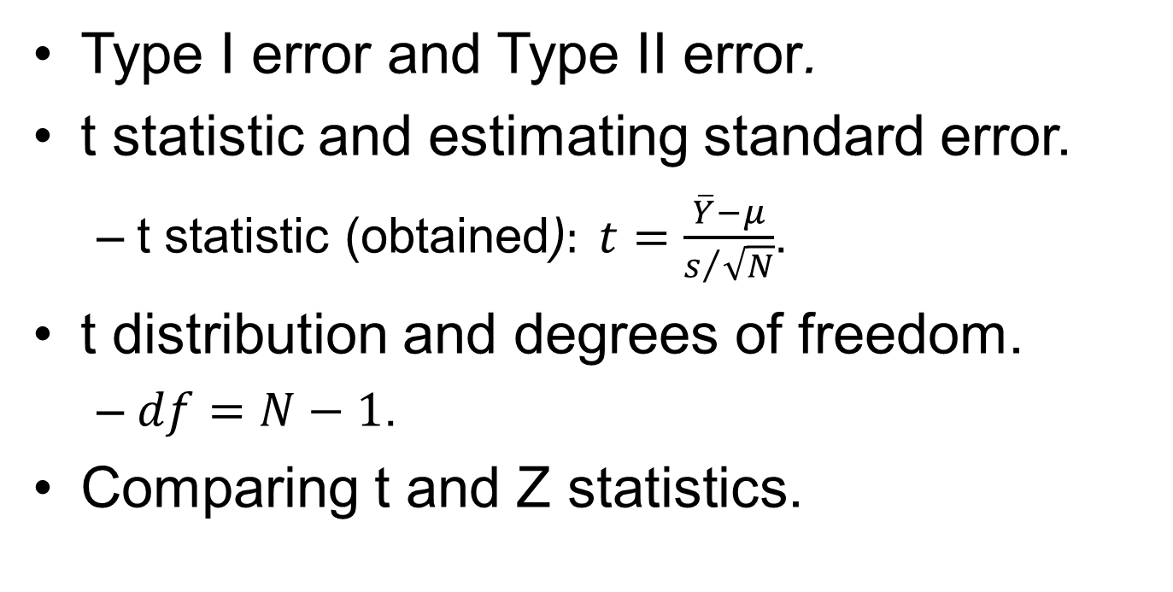
Errors in Hypothesis Testing (1 of 2)
Type I error and Type II error.
t Statistic and estimating standard error.
t Statistic (obtained)$: t=\frac{\overline{Y}−μ}{s/{\sqrt{N}}}$.
t Distribution and degrees of freedom.
$df=N−1$.
Comparing t and Z statistics.
Notes:
Satisfies Learning Objective 8.5: Determine the significance of t-test and Z-test statistics.
Type I error and Type II error: The null hypothesis can be either true or false, and in either case, it can be rejected or not rejected.
If the null hypothesis is true and we reject it nonetheless, we are making an incorrect decision. This type of error is called a Type I error.
If the null hypothesis is false but we fail to reject it, this incorrect decision is a Type II.
The t statistic and estimating the standard error:
t Statistic (obtained)$: t=\frac{\overline{Y}−μ}{s/{\sqrt{N}}}.$
The obtained t represents the number of standard deviation units (or standard error units) that the sample mean is from the hypothesized value of μ, assuming that the null hypothesis is true.
The t distribution and degrees of freedom:
The t distribution is actually a family of curves, each determined by its degrees of freedom.
The degrees of freedom (df) represent the number of scores that are free to vary in calculating each statistic.
In the case of a single-sample mean, the df is calculated as follows: $df=N−1$.
Comparing the t and Z statistics:
The only apparent difference is in the denominator. The denominator of Z is the standard error based on the population standard deviation σ.
There is another important difference between the Z and t statistics: Because it is estimated from sample data, the denominator of the t statistic is subject to sampling error.

Slide 11
Errors in Hypothesis Testing (2 of 2)
Table 8.1 Type I and Type II Errors
Decision Made | True State of Affairs
 | H₀ Is True | H₀ Is False
Reject H0 | Type i error (α) | Correct decision
Do not reject H0 | Correct decision | Type ii error
Notes:
Satisfies Learning Objective 8.5: Determine the significance of t-test and Z-test statistics.
Table 8.1: Type I and Type II Errors.
We can control the risk of rejecting a true hypothesis by manipulating alpha. For example, by setting alpha at 0.01, we are reducing the risk of making a Type I error to 1%. Unfortunately, however, Type I and Type II errors are inversely related; thus, by reducing alpha and lowering the risk of making a Type I error, we are increasing the risk of making a Type II error.

Slide 12
Hypothesis Testing with One Sample and Population Variance Unknown (1 of 2)
Making assumptions.
Stating the research and null hypotheses and selecting alpha.
Selecting the sampling distribution and specifying the test statistic.
Notes:
Satisfies Learning Objective 8.2: Define and apply the components in hypothesis testing.
Making assumptions: Our assumptions are as follows:
A random sample is selected.
Because N > 50, the assumption of normal population is not required.
The level of measurement of the variable income is interval ratio.
Stating the research and the null hypotheses and selecting alpha:
The research hypothesis is $H_{1}:μ>\$41,977$and the null hypothesis is $H_{0}:μ=\$41,977$. We’ll set alpha at 0.05, meaning that we will reject the null hypothesis if the probability of our obtained statistic is less than or equal to 0.05.
Selecting the sampling distribution and specifying the test statistic: We use the t distribution and the t statistic to test the null hypothesis.

Slide 13
Hypothesis Testing with One Sample and Population Variance Unknown (2 of 2)
Computing the test statistic.
Making a decision and interpreting the results.
Notes:
Satisfies Learning Objective 8.2: Define and apply the components in hypothesis testing.
Computing the test statistic:
We first calculate the df associated with our test: $df=\left(N−1\right)=\left(280−1\right)=279$.
To evaluate the probability of obtaining a sample mean of $45,785, assuming the average earnings of white women were equal to the national average of $41,977, we need to calculate the obtained t statistic, $t=\frac{\overline{\overline{Y}−μ}}{s/{\sqrt{N}}}=\frac{45,785−41,977}{{25,563}/{\sqrt{280}}}=\frac{3808}{1527.68}=2.49$.
Making a decision and interpreting the results:
Given our research hypothesis, we will conduct a two-tailed test. We can see that 279 degrees of freedom is not listed, so we’ll have to use the last row, df = ∞, to assess the significance of our obtained t statistic.
Our obtained t statistic of 2.49 is not listed in the last row. It is greater than 2.326 (t critical for 0.01 one-tailed test), but less than 2.576 (t critical for 0.005 one-tailed test).
The probability of 2.49 can be estimated as $p<0.05$, leading to the conclusion that we reject the null hypothesis.

Slide 14
Hypothesis Testing with Two Sample Means
Hypothesis testing with two samples.
Assumption of independent samples.
Stating research and null hypotheses.
Notes:
Satisfies Learning Objective 8.4: Calculate and interpret a test for two sample cases with means or proportions.
Hypothesis testing with two samples follows the same structure as for one-sample tests: The assumptions of the test are stated, the research and null hypotheses are formulated and the alpha level selected, the sampling distribution and the test statistic are specified, the test statistic is computed, and a decision is made whether or not to reject the null hypothesis.
The assumption of independent samples:
One important difference between one- and two-sample hypothesis testing involves sampling procedures.
With a two-sample case, we assume that the samples are independent of each other.
Stating the research and null hypotheses:
The second difference between one- and two-sample tests is in the form taken by the research and the null hypotheses.
In one-sample tests, both the null and the research hypotheses are statements about a single population parameter, μ.

Slide 15
The Sampling Distribution of the Difference between Means (1 of 3)
Sampling distribution of difference between means.
Corollary to central limit theorem.
Estimating standard error.
Notes:
Satisfies Learning Objective 8.4: Calculate and interpret a test for two sample cases with means or proportions.
Sampling distribution of the difference between two sample means: Theoretical probability distribution that would be obtained by calculating all the possible mean differences by drawing all possible independent random samples of size N₁ and N₂ from two populations.
Corollary to the central limit theorem: The properties of the sampling distribution of the difference between two sample means are determined by a corollary to the central limit theorem.
Estimating the standard error: The only data we have are based on sample data, and we do not know the true value of the population variances, $σ_{1}^{2}$ and $σ_{2}^{2}$. Thus, we need to estimate the standard error from the sample variances, $s_{1}^{2}$ and $s_{2}^{2}$. The estimated standard error of the difference between means is symbolized as $s_{{\overline{Y}}_{1}−{\overline{Y}}_{2}}$ (instead of $σ_{{\overline{Y}}_{1}−{\overline{Y}}_{2}}$).

Slide 16
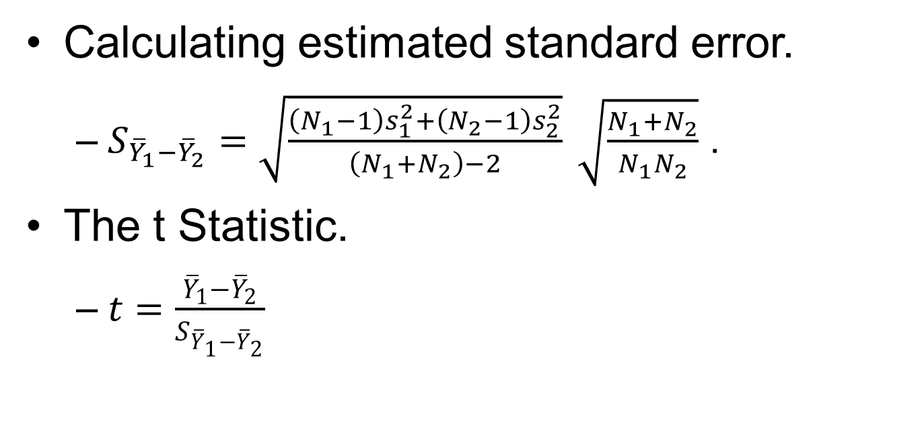
The Sampling Distribution of the Difference between Means (2 of 3)
Calculating estimated standard error.
$S_{{\overline{Y}}_{1}−{\overline{Y}}_{2}}=\sqrt{\frac{\left(N_{1}−1\right)s_{1}^{2}+\left(N_{2}−1\right)s_{2}^{2}}{\left(N_{1}+N_{2}\right)−2}} \sqrt{\frac{N_{1}+N_{2}}{N_{1}N_{2}}}$ .
The t statistic.
$t=\frac{{\overline{Y}}_{1}−{\overline{Y}}_{2}}{S_{{\overline{Y}}_{1}−{\overline{Y}}_{2}}}$
Notes:
Satisfies Learning Objective 8.4: Calculate and interpret a test for two sample cases with means or proportions.
Calculating the estimated standard error: We can assume that the two population variances are equal, we combine information from the two sample variances to calculate the estimated standard error:
$S_{{\overline{Y}}_{1}−{\overline{Y}}_{2}}=\sqrt{\frac{\left(N_{1}−1\right)s_{1}^{2}+\left(N_{2}−1\right)s_{2}^{2}}{\left(N_{1}+N_{2}\right)−2}} \sqrt{\frac{N_{1}+N_{2}}{N_{1}N_{2}}}$
where $S_{{\overline{Y}}_{1}−{\overline{Y}}_{2}}$ is the estimated standard error of the difference between means, and $s_{1}^{2}$ and $s_{2}^{2}$ are the variances of the two samples.
The t statistic:
As with single sample means, we use the t distribution and the t statistic whenever we estimate the standard error for a difference between means test.
The formula for computing the t statistic for a difference between means test is $t=\frac{{\overline{Y}}_{1}−{\overline{Y}}_{2}}{S_{{\overline{Y}}_{1}−{\overline{Y}}_{2}}}$
where $S_{{\overline{Y}}_{1}−{\overline{Y}}_{2}}$ is the estimated standard error.

Slide 17
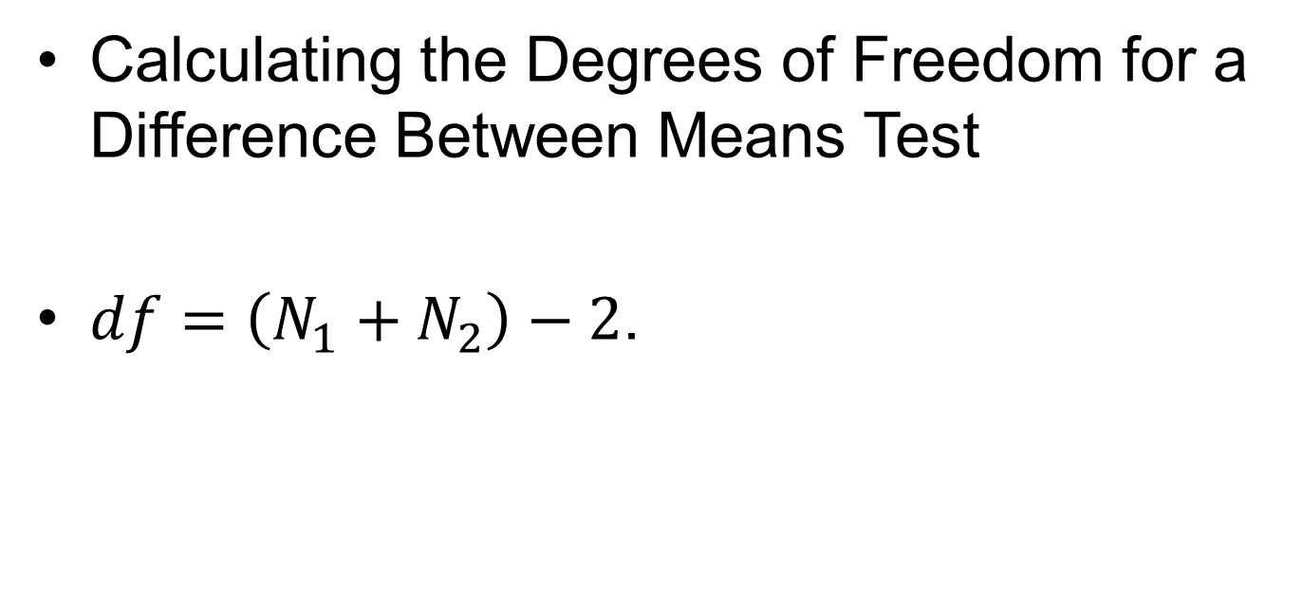
The Sampling Distribution of the Difference between Means (3 of 3)
Calculating the degrees of freedom for a difference between means test.
$df=\left(N_{1}+N_{2}\right)−2$.
Notes:
Satisfies Learning Objective 8.4: Calculate and interpret a test for two sample cases with means or proportions.
To use the t distribution for testing the difference between two sample means, we need to calculate the degrees of freedom.
When calculating the t statistic for the two-sample test, we lose 2 degrees of freedom, one for every population variance we estimate.
When population variances are assumed to be equal or if the size of both samples is greater than 50, the df is calculated as follows: $df=\left(N_{1}+N_{2}\right)−2$.

Slide 18
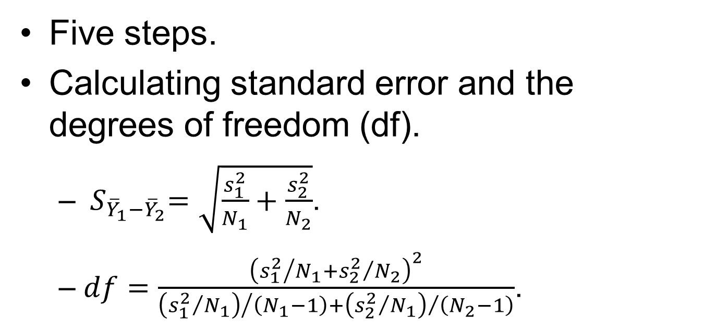
The Five Steps in Hypothesis Testing about Difference between Means: A Summary
Five steps.
Calculating standard error and the degrees of freedom (df).
${ S}_{{\overline{Y}}_{1}−{\overline{Y}}_{2}}=\sqrt{\frac{s_{1}^{2}}{N_{1}}+\frac{s_{2}^{2}}{N_{2}}}$.
$df=\frac{{\left({s_{1}^{2}}/{N_{1}+{s_{2}^{2}}/{N_{2}}}\right)}^{2}}{{\left({s_{1}^{2}}/{N_{1}}\right)}/{\left(N_{1}−1\right)+{\left({s_{2}^{2}}/{N_{1}}\right)}/{\left(N_{2}−1\right)}}}$.
Notes:
Satisfies Learning Objective 8.4: Calculate and interpret a test for two sample cases with means or proportions.
Statistical hypothesis testing involving two sample means can be organized into five steps:
Making assumptions.
Stating the research and null hypotheses and selecting alpha.
Selecting the sampling distribution and specifying the test statistic: The t distribution and the t statistic are used to test the significance of the difference between the two sample means.
Computing the test statistic.
Making a decision and interpreting the results.
Calculating the estimated standard error and the degrees of freedom (df) when the population variances are assumed to be unequal:
If the variances of the two samples ($s_{1}^{2} and s_{2}^{2}$) 1, 2, 2, and 2 are very different (one variance is twice as large as the other), the formula for the estimated standard error becomes${: S}_{{\overline{Y}}_{1}−{\overline{Y}}_{2}}=\sqrt{\frac{s_{1}^{2}}{N_{1}}+\frac{s_{2}^{2}}{N_{2}}}$.
When the population variances are unequal and the size of one or both samples is equal to or less than 50, we use another formula to calculate the degrees of freedom associated with the t statistic: $df=\frac{{\left({s_{1}^{2}}/{N_{1}+{s_{2}^{2}}/{N_{2}}}\right)}^{2}}{{\left({s_{1}^{2}}/{N_{1}}\right)}/{\left(N_{1}−1\right)+{\left({s_{2}^{2}}/{N_{1}}\right)}/{\left(N_{2}−1\right)}}}.$

Slide 19
Hypothesis Testing with Two Sample Proportions
Variables measured at nominal or ordinal level.
Same structure as statistical tests.
Apply five-step model.
Notes:
Satisfies Learning Objective 8.4: Calculate and interpret a test for two sample cases with means or proportions.
Numerous variables in the social sciences are measured at a nominal or an ordinal level. These variables are often described in terms of proportions or percentages.
Same structure as statistical tests: Hypothesis testing with two sample proportions follows the same structure as the statistical tests presented earlier.

